Slide 1

Data Preprocessing in Data Mining
Name:Tanishka
Branch: CSE CORE(I)
Reg.no: RA2311003030589
Subject:Data Mining &Analytics(21CSE355T)
Notes:
1

Slide 2

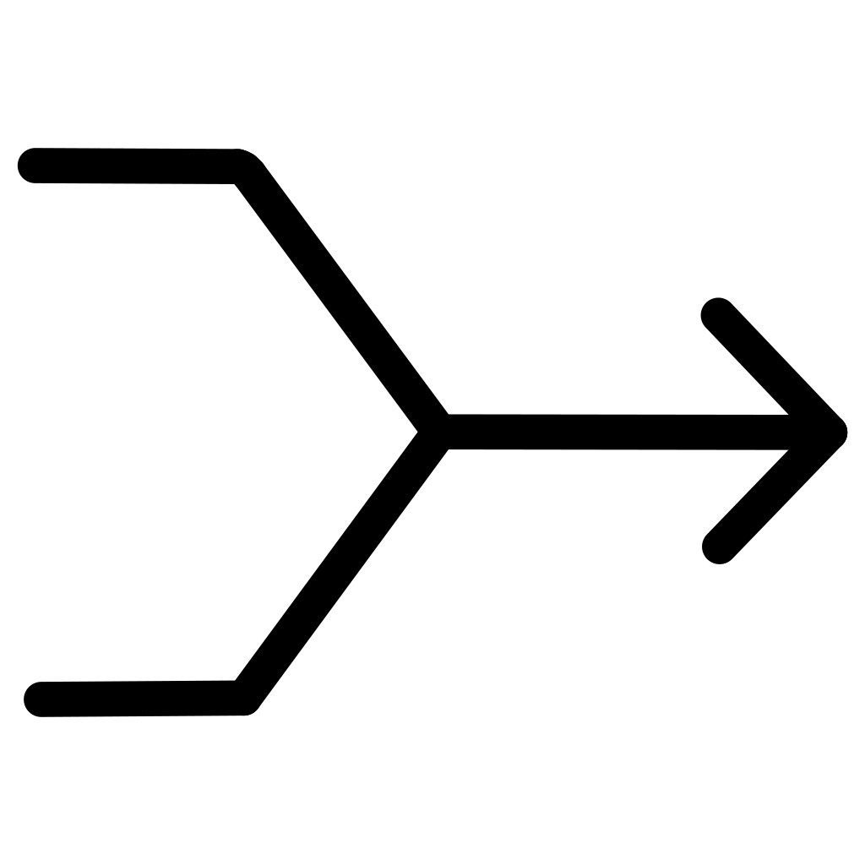

What is Data Preprocessing?
Data Cleaning
Data Integration
Data Transformation
Remove errors and inconsistencies
Combine multiple sources
Convert to suitable format
Preprocessing transforms raw data into quality data for mining
Notes:
2

Slide 3

Why Preprocessing is Essential
Real-World Data Problems
The Impact
Incomplete entries
Noisy measurements
Inconsistent formats
Large volume
Without preprocessing: inaccurate results, unreliable models
With preprocessing: trustworthy insights, better predictions
Notes:
3

Slide 4





The Complete Preprocessing Pipeline
Data Cleaning
Missing values, noise, outliers
Data Integration
Multiple sources combined
Data Transformation
Normalization, scaling
Data Reduction
Smaller, efficient datasets
Data Discretization
Continuous to discrete
Notes:
4

Slide 5

Data Cleaning Techniques
Handling Missing Values
01
Mean/Median/Mode
Fill with central tendency
02
Ignore Tuple
Remove incomplete records
03
Predict Value
Use algorithms to estimate
Goal: Remove inconsistencies while preserving data integrity
Notes:
5

Slide 6


Noise & Outlier Detection
Binning
Regression
Clustering
Group values into bins, smooth using bin means
Fit data to function, identify deviations
Group similar values, detect isolated points
Z-Score Method
If |Z| > 3 → Outlier detected
Notes:
6

Slide 7

Data Integration Challenges
Schema Mismatch
Data Redundancy
Different structures across databases
Duplicate information stored multiple times
Conflicting Values
Same entity, different representations
Example: Customer stored differently in two systems
Notes:
7

Slide 8



Data Transformation Methods
Other Techniques
Aggregation: Summarize data
Discretization: Convert continuous to discrete
Attribute construction: Create new features
Normalization Techniques
Min-Max Normalization
Scale to [0, 1] range
Z-Score Standardization
Mean=0, std=1
Notes:
8

Slide 9




Data Reduction Strategies
Sampling
Dimensionality Reduction
Select representative subset while maintaining data distribution characteristics
Reduce features using PCA, SVD while preserving important patterns
Attribute Selection
Data Cube Aggregation
Keep only relevant attributes, remove redundant or irrelevant features
Precompute summary data for faster query processing
Benefits: Faster computation, reduced storage, improved efficiency
Notes:
9

Slide 10

Key Takeaways
Quality depends on data quality
Garbage in, garbage out—preprocessing is non-negotiable
Improves model performance
Clean data leads to accurate predictions and reliable results
Reduces computational cost
Smaller datasets mean faster processing and less storage
"Data preprocessing is the foundation of successful data mining—invest time here to reap rewards downstream."
Notes:
10

Slide 11


